Slide 1
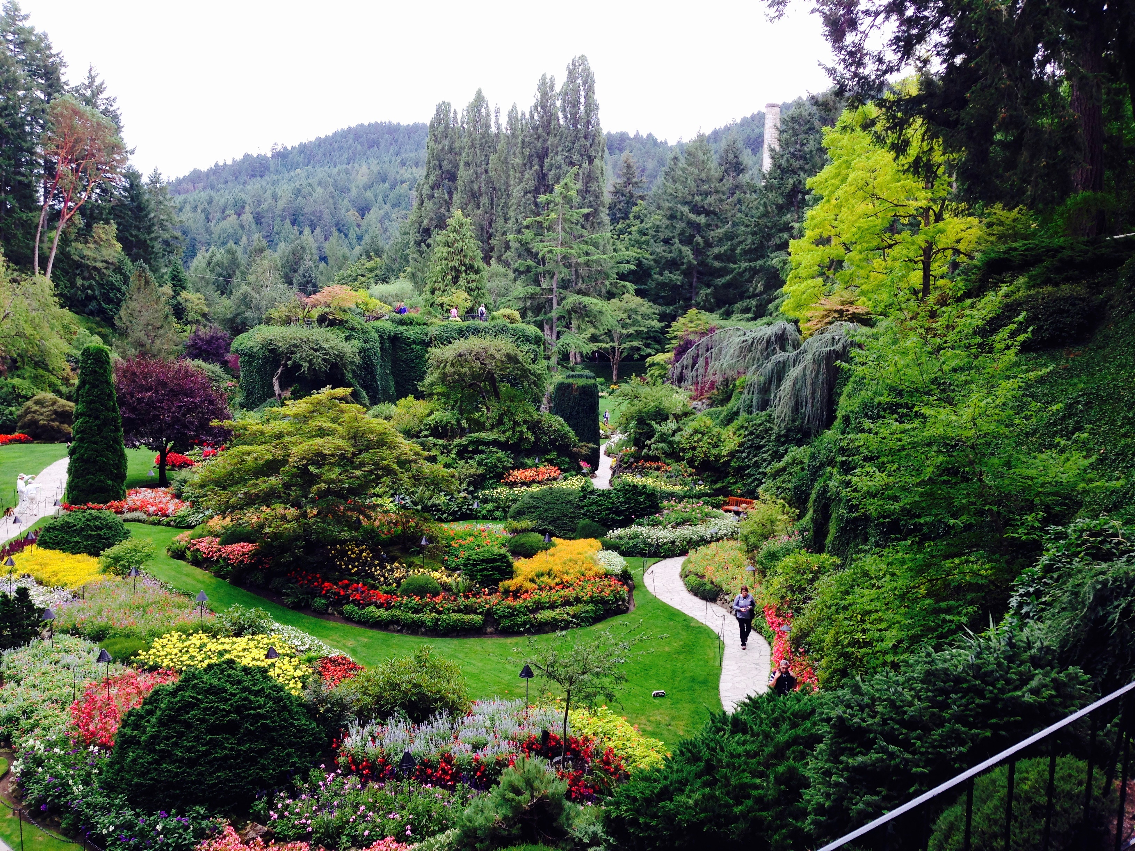
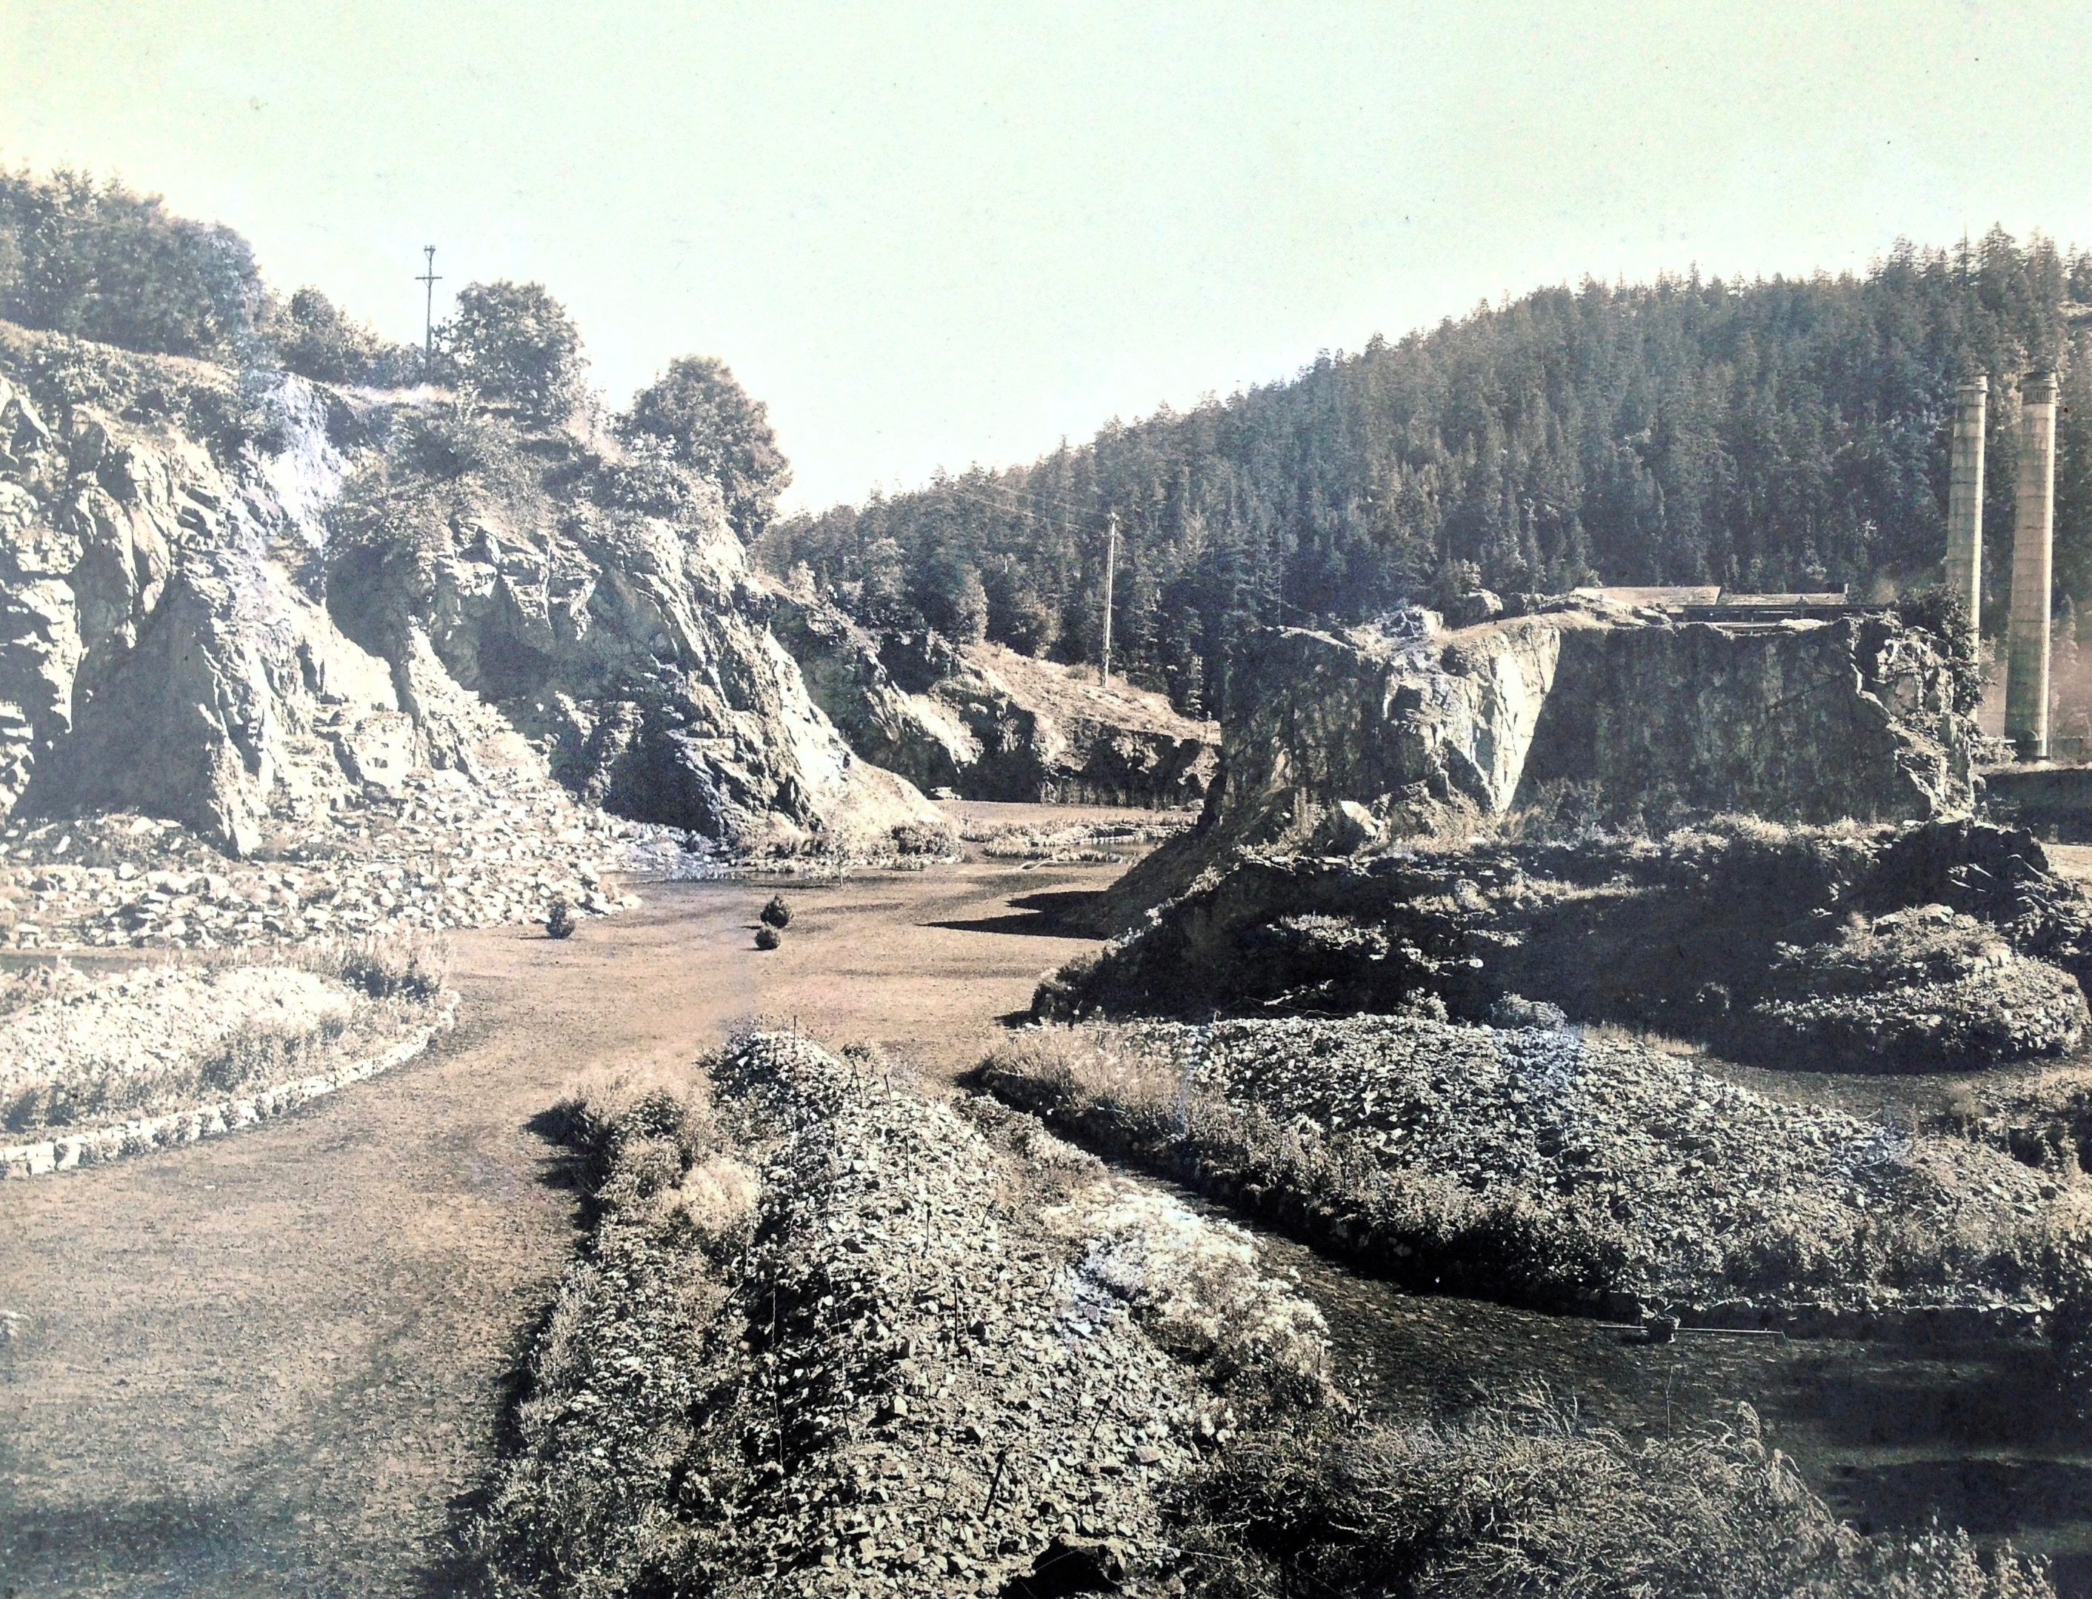
Harness Your
Organization's
Data

Slide 2
Employees spend nearly 2 hours every day searching and gathering information.
9 hours per week, on average.
Source: McKinsey: Time Searching for Information
Impact of Searching….
For every four people working
One is searching..
Notes:
19 per cent of business time – the equivalent of one day per working week – is spent by employees searching for information that they need to do their jobs.
Source: Interac: A Fifth of Business Time is Wasted Searching for Information, says Interact
Put another way, for every four people you have working, one person is searching for something.

Slide 3
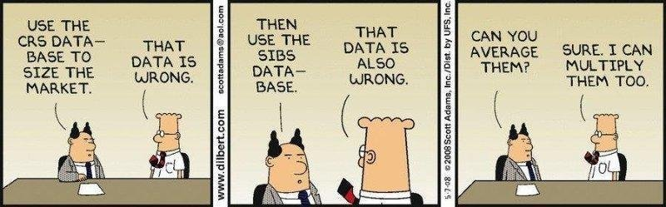
Getting good data is HARD..
Notes:
Different data standards and formats, data quality is a major issue, files and file names are a nightmare.

Slide 4
Growth Makes it Harder to Manage Data
More People = More Teams
More Teams = More Processes
More processes = more systems
More systems = more data
http://www.businessinsider.com/slack-ceo-stewart-butterfield-and-box-ceo-aaron-levie-bots-making-work-more-efficient-2016-8
Notes:
With more people, you need more teams, with more teams, you have more processes and with more processes, you have more systems.
Knowledge becomes scattered, siloed, and fragmented, making it difficult to quickly bring together the deep and valuable knowledge has, and to quickly find the right person to answer your question.

Slide 5

In 2010, The Economist published ‘The Data Deluge’
“Since 2010, the role of data in business and society has grown.
Data has become the oil of the information economy: a vital corporate asset. “
Economist Intelligence Unit: The data deluge 5 years on
Notes:
And the amount of data firms are having to managing is also growing.

Slide 6
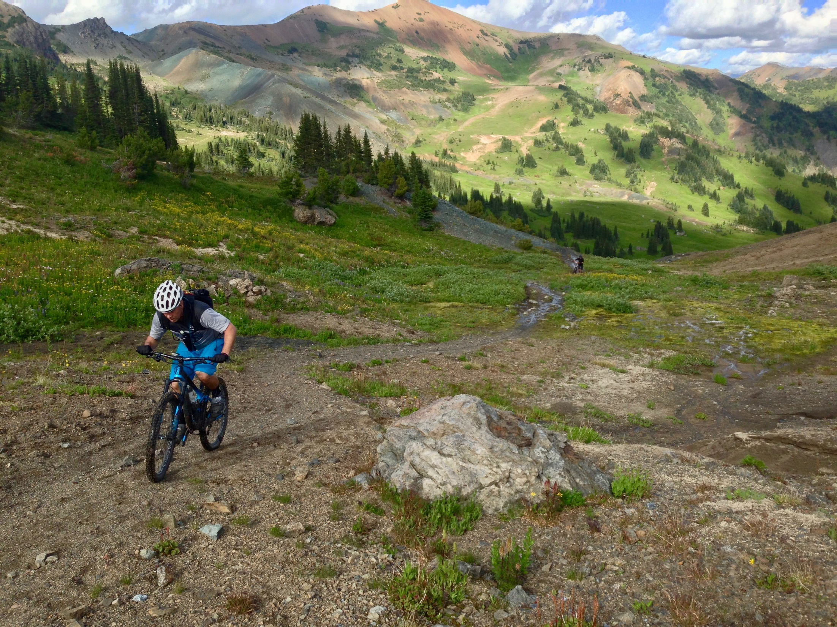
Integrating data effectively is an uphill battle!
Slack uses 80 different pieces of software even though it has only about 350 employees.”
Companies typically use:
7 Different Enterprise Systems
2-3 File Store Providers (dropbox, OneDrive etc)
Many databases
Countless Spreadsheets
Different formats:
XML
CSV
Json
Relational
How can we solve this challenge?

Slide 7
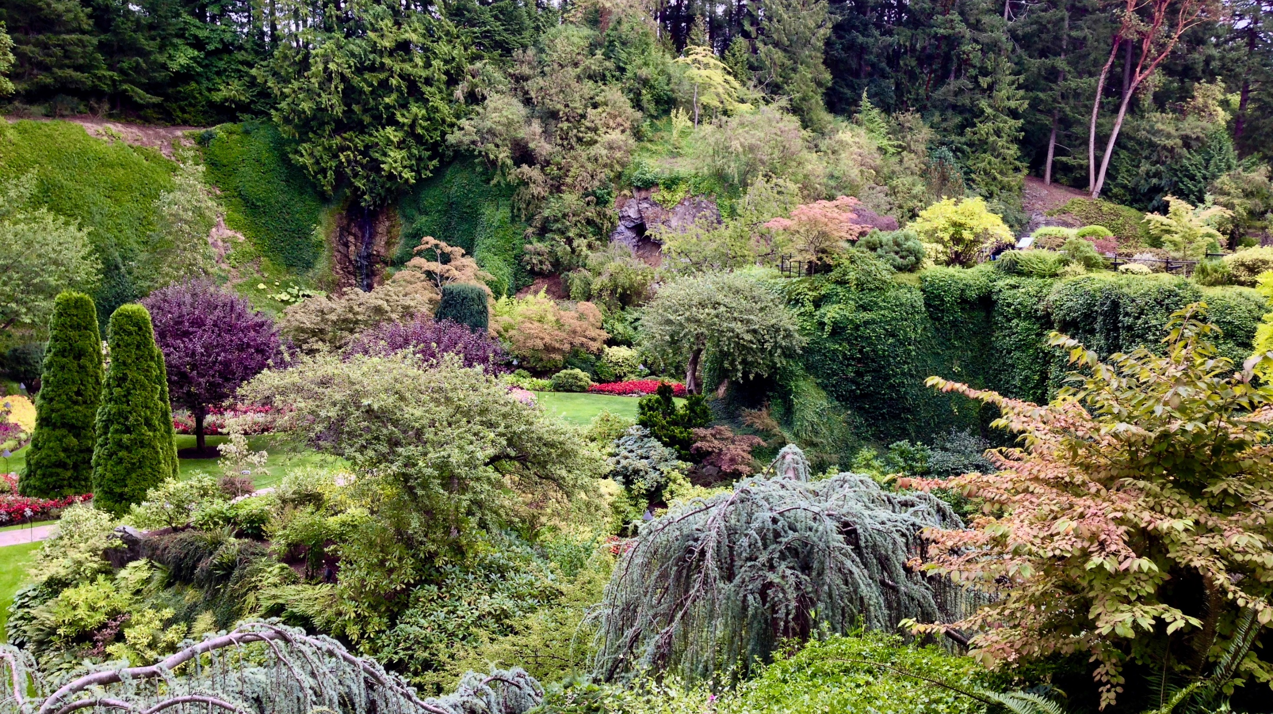
We need to rethink how we represent data in order to integrate it

Slide 8
Rethinking how we represent data
DATA
DATA
Notes:
Data doesn’t actually start off as rectangular.

Slide 9
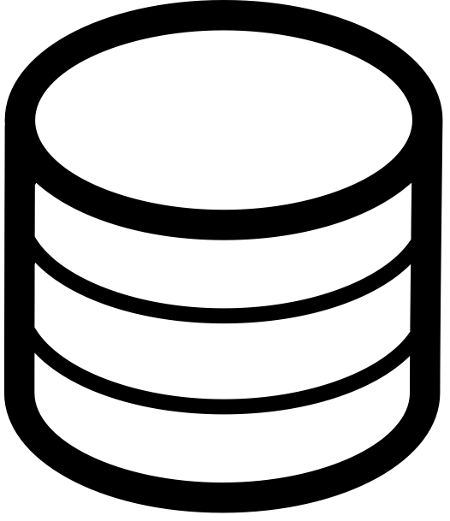
Rethinking how we represent data
Relational Database
DATA
Good for:
• Well-understood data structures that don’t change too frequently
• Known problems involving discrete parts of the data, or minimal connectivity
Notes:
The standard relational approach forces you to transform the data into tables and keys – it forces the data into a static pattern. This has advantages for known sets of data in terms of performance: but it is a lot of work to get the data into this shape, and its brittle. If the shape of the data changes, it’s a huge amount of work to adjust.

Slide 10
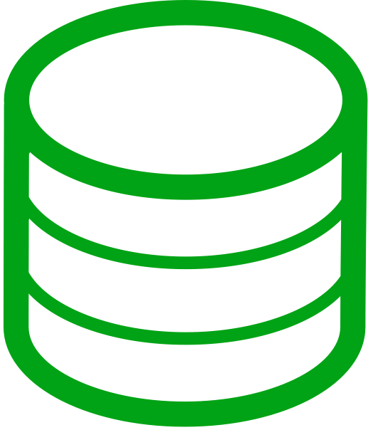
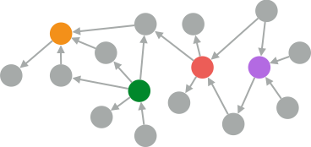

Rethinking how we represent data
Relational Database
Graph Database
Good for:
• Well-understood data structures that don’t change too frequently
Good for:
• Dynamic systems: where the data topology is difficult to predict
• Known problems involving discrete parts of the data, or minimal connectivity
• Dynamic requirements: the evolve with the business
• Problems where the relationships in data contribute meaning & value
HARD:
Requires transforming the data
Maintenance requires a lot of work
Brittle – will break with the smallest change
SOFT:
Accepts data closer to its natural shape
Is adaptable: can adjust to new and changing patterns

Slide 11

EXPLAIN —> VALIDATE
THE PROPERTY GRAPH DATA MODEL
Notes:
First, not everyone in the room would know what a graph is.

Slide 12
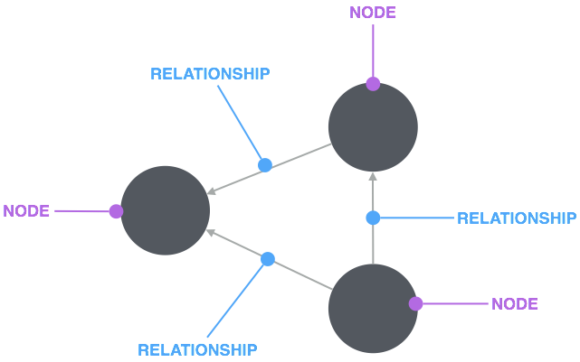
I’ve had trouble with this animation sequence. Let’s try this, which I
think will help: when the circles appear, let’s have a click animation
that reveals the word “nodes” and after we show the relationships,
a click animation showing the word “relationships” to denote
the relationships
A Graph Is
Notes:
A graph is connected data.
Which essentially means – datapoints that have relationships with other datapoints.

Slide 13
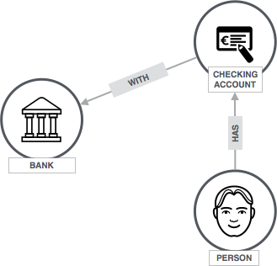
I’ve had trouble speaking to these and would love to redo them.
Here, can we please change to Person has Checking account with a Bank?
A Graph Is
Notes:
Or a hotel that has rooms, which have availability

Slide 14
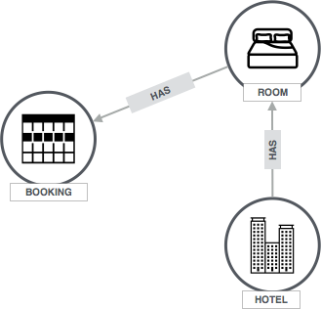
I’m good with this one - let’s leave it. It should have the exact same shape
as the previous one, which makes the point that the same
shape can represent different things
A Graph Is
Notes:
Or a hotel that has rooms, which have availability

Slide 15
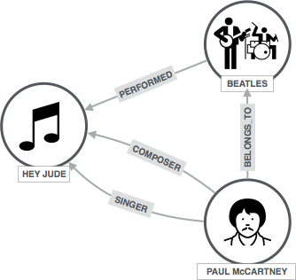
Here I’d like to start with the same shape and extend it with
a few more relationships. Let’s use a music graph, since some folks from Apple
will be there.
Paul McCartney (bottom-right) -[:BELONGS_TO]->Beatles (top right)
with Beatles-[:PERFORMED]->(Hey Jude) left
and then add two more relationships:
(Paul McCartney-[:Singer]->(Hey Jude), and
(Paul McCartney-[:Composer]->(Hey Jude)
A Graph Is
Notes:
Or a hotel that has rooms, which have availability

Slide 16
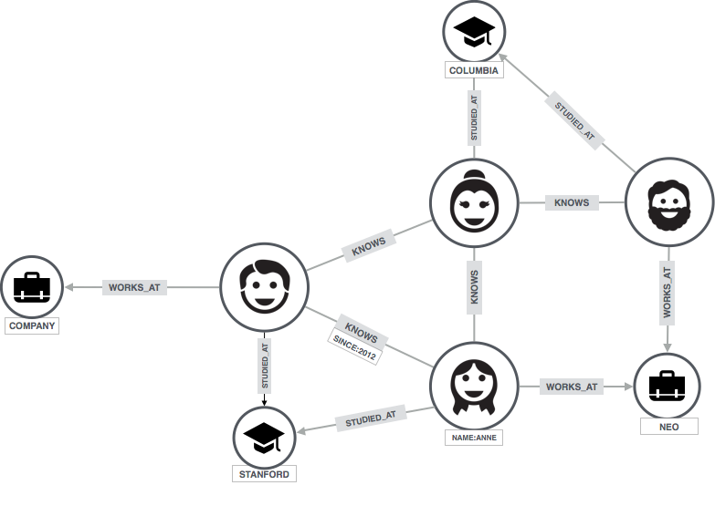
Looks good. Could you please just make “property”
a separate animation (after “node” and “relationship”
show up together)?
PROPERTY
A Graph Is
Notes:
Or it could be people who know other people – who know other people.. who studied together, who work at the same place – who studied with other people, who works somewhere else… etc.

Slide 17
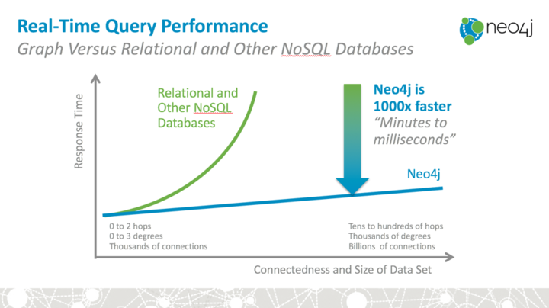
Real-Time Query Performance
1000x Advantage
Relational and Other NoSQL Databases
Response Time
“Minutes to milliseconds”
Neo4j
0 to 2 hops
0 to 3 degrees
Thousands of connections
Tens to hundreds of hops Thousands of degrees
Billions of connections
Connectedness and Size of Data Set
Notes:
Past three hops in the SQL, this becomes impossible to do. In neo4j this is normal.

Slide 18
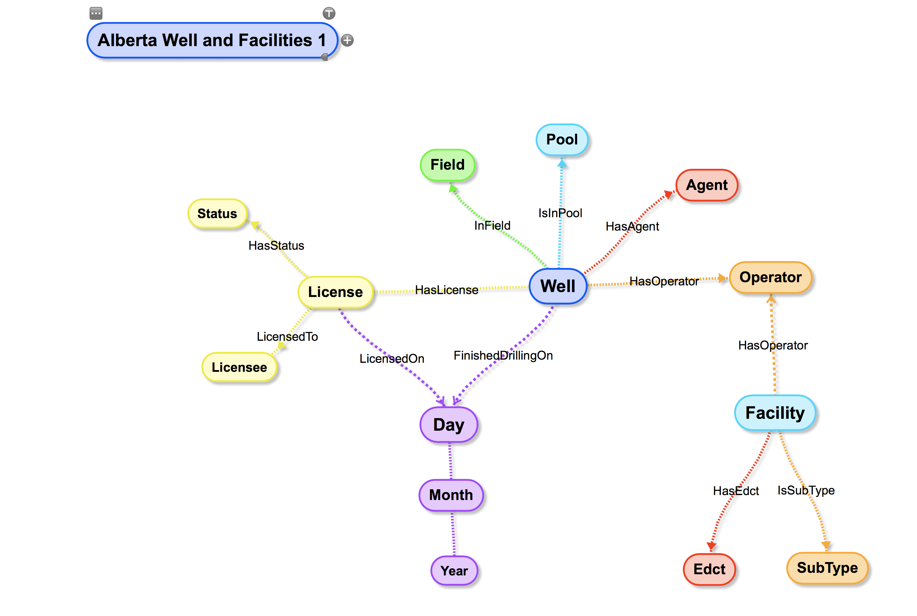
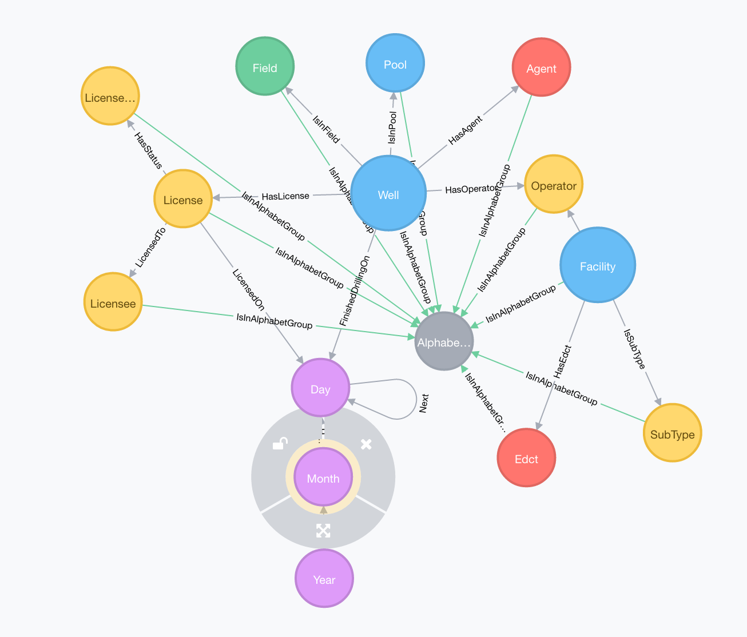
Intuitivness
=
Conceptual Data Model
Neo4j Data Model
Notes:
The graph model is

Slide 19
Intuitivness
Speed
Agility/Flexibility
= Great for Integrating Data!
Notes:
There are lots of other reasons that Neo4j is awesome, but for today I will focus on the data integration side.

Slide 20
What Neo4j Has Solved
Graph Model – but still ACID transactional compliance
Graph Model – but still performant and scalable
Graph Model – but offers security down to the property level
Graph Model – flexible modelling, but able to query like a SQL database
Quick, flexible data integration
Great query language – Cypher!

Slide 21
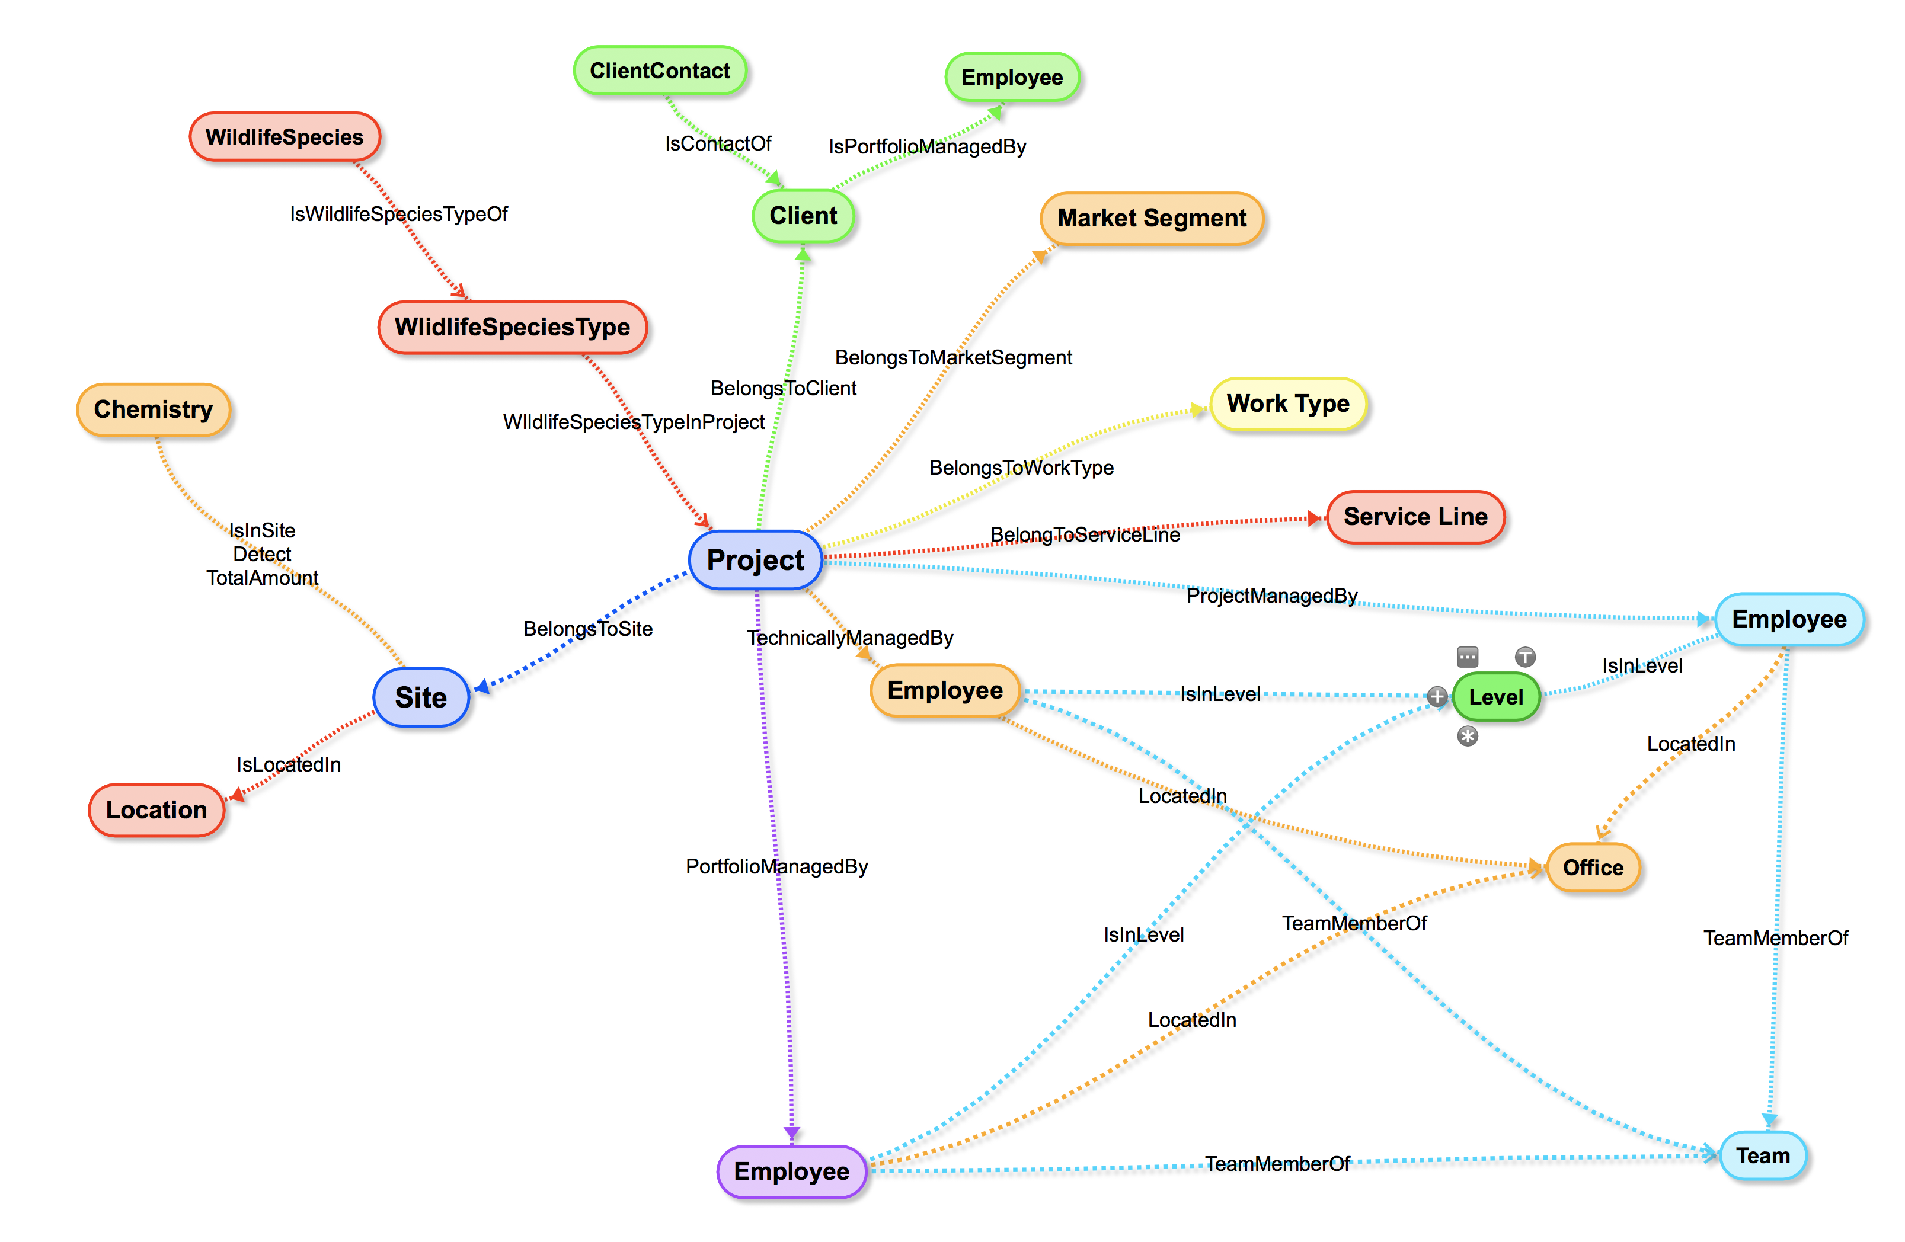
Product
CRM
Financial
Marketing
Environmental
Enterprise Sources
RDBMS
RDBMS
RDBMS
RDBMS
RDBMS
File Based Sources
Data Integration
Web Service Sources
Limits ability to relate data
Notes:
Typical Scenario: You will have systems in place to perform different functions, all of them probably crucial and doing the job btw, The problem is that these systems are designed to perform a very specific task.
So in order to put the data from all these systems to good use effectively, in the recommendations-example we just showed you, in real-time you need to add the graph database-layer.
Neo4j makes pulling these data together easier. Unlike

Slide 22
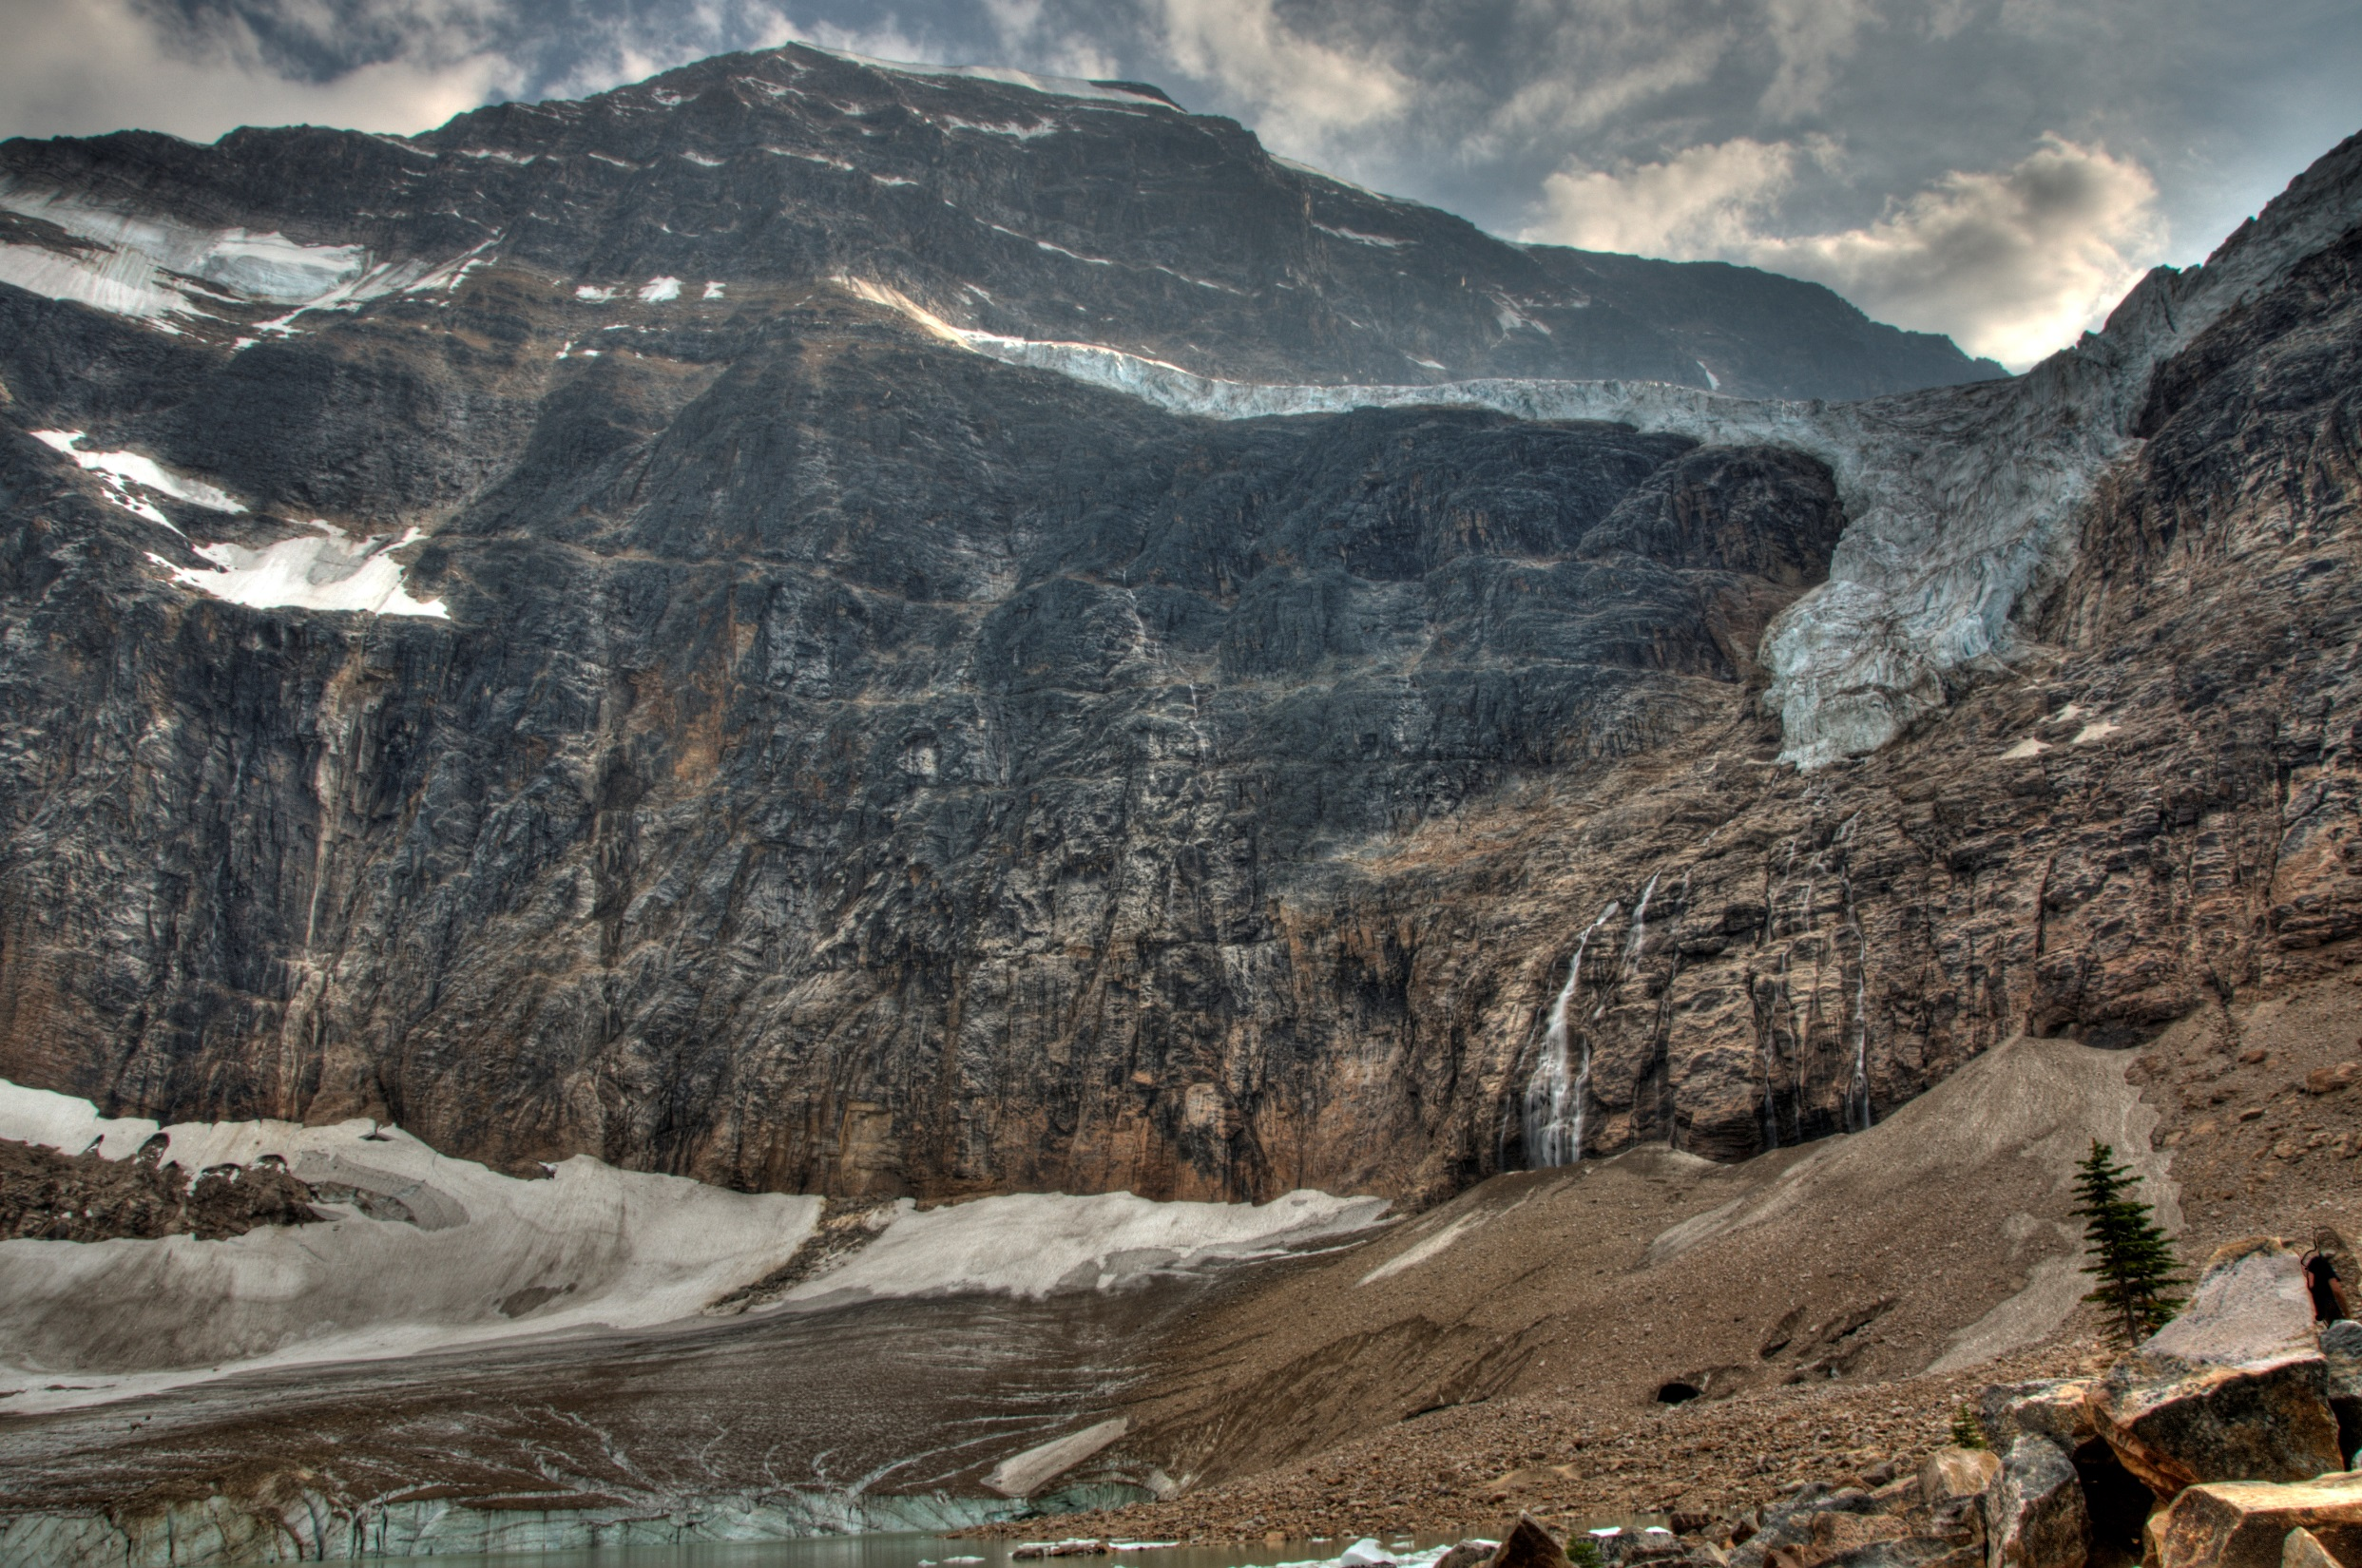
Demo Time!

Slide 23
Data Integration Demo
Take base data from Alberta Energy Regulator and combine it into a graph of Wells, Facilities, Licensees with as little pre-processing as possible:
Converted to CSV, Cleaned up & Added headers (could do this in Cypher as well), Transformed coordinates to WGS84 (could do this with the neo4j spatial extension)
ActiveFacility_edctCodes.csv
ActiveFacility.csv
FieldList.csv
LicenseeAgent_Codes.csv
WellListLocationsWGS84.csv
More data is available
https://www.aer.ca/data-and-publications/statistical-reports

Slide 24
Cypher – Describe a Pattern…
MATCH (f:Facility)-[r:Spilled]->(s:Spill) RETURN f,c
Node
Relationship
Node
If you can follow a path between nodes, you can describe it..It is easy to describe and chain together complex patterns.
Cypher’s simplicity is its power.

Slide 25
Well List:
PoolNode
StatusNode
LicenseeNode
X | Y | UWI | KeyList | Update | Name | Field | Pool | OSArea | OSDep | LicStatus | License | LicDate | Licensee | Agent | Operator | FDDate | TotalDep | WellStat | StatDate
-110.133808 | 49.004621 | 00/06-06-001-01W4/0 | 14010606000 |  | CMG PCGAS WILDHORSE 6-6-1-1 | 998 | 0 |  | 0 | RecCertified | 65081 | 19770803 | A5D40 |  |  | 19770820 | 1204 | 2000000 | 19770824
-110.133808 | 49.004621 | F1/06-06-001-01W4/0 | 0014010606F10 |  | HEYLAUFF WILDHORSE DW 6-6-1-1 | 961 | 158098 |  | 0 | Issued | 78503 | 19791009 | 0FF30 |  |  | 19770820 | 1205 | 600080000 | 19770822
-110.069408 | 49.019302 | F1/05-10-001-01W4/0 | 0014011005F10 |  | BORDER FELDON DW 5-10-1-1 | 998 | 0 |  | 0 | Issued | 107524 | 19840607 | A2450 |  |  | 19840624 | 391.4 | 600080000 | 19840626
-110.061893 | 49.020664 | 00/06-10-001-01W4/0 | 14011006000 |  | HERTZ MINERALS CRESSDAY 6-10-1-1 | 998 | 0 |  | 0 | RecCertified | 50356 | 19740705 | 0T690 |  |  | 19740710 | 1216.2 | 2000000 | 19740712
-110.043292 | 49.038414 | 00/11-14-001-01W4/0 | 14011411000 |  | CANDEL ET AL FELDON 11-14-1-1 | 998 | 0 |  | 0 | RecCertified | 83713 | 19800625 | 0K210 |  |  | 19800730 | 847 | 2000000 | 19800731
-110.049329 | 49.042937 | 00/13-14-001-01W4/0 | 14011413000 |  | SOCONY 15 CYPRESS HILLS TH 13-14-1-1 | 998 | 0 |  | 0 | RecExempt | 0004123L | 19520125 | 570 |  |  | 19520125 | 244 | 2000000 | 19520126
-110.094564 | 49.042727 | W0/13-16-001-01W4/0 | 0014011613W00 |  | SOCONY 13 CYPRESS HILLS TH 13-16-1-1 | 998 | 0 |  | 0 | RecExempt | 0004123J | 19520125 | 570 |  |  | 19520125 | 244 | 2000000 | 19520126
FieldNode
LicenseNode
OperatorNode
Goal is to take this in one shot and transform it into a graph of nodes and relationships without additional manipulation

Slide 26
Initial Model
Lets us see relationships between:
License status, operators wells and facilities they are linked to
License dates, Well completion dates
Location of Facilities and Wells

Slide 27
Import Wells
// Well Node
USING PERIODIC COMMIT 1000
LOAD CSV WITH HEADERS FROM 'file:///theLinkHNI/WellListLocationsWGS84.csv' AS line // with line limit 100
// create uuid
CALL apoc.create.uuids(1) YIELD uuid as wuuid
MERGE (c:Well { Uwi: line.UWI })
ON CREATE set
c.Uuid = wuuid,
c.LSD = (substring(line.UWI,3,14)),
c.Keylist = line.Keylist,
c.Name= line.Name,
c.TotalDepth= line.TotalDep,
c.WellStat= line.WellStat,
c.StatDate= line.StatDate,
c.FDDate= line.FDDate,
c.Latitude= toFloat(line.Y),
c.Longitude= toFloat(line.X);
Well Node

Slide 28
Import Fields
// Field Name
USING PERIODIC COMMIT 1000
LOAD CSV WITH HEADERS FROM 'file:///theLinkHNI/WellListLocationsWGS84.csv' AS line //with line limit 100
CALL apoc.create.uuids(1) YIELD uuid as fuuid
MERGE (f:Field {Name: line.Field})
ON CREATE set
f.Uuid= fuuid;
// Well isInField Field
USING PERIODIC COMMIT 1000
LOAD CSV WITH HEADERS FROM 'file:///theLinkHNI/WellListLocationsWGS84.csv' AS line //with line limit 100
MATCH(w:Well {Uwi:line.UWI})
MATCH(f:Field {Name: line.Field})
MERGE (w)-[:IsInField]->(f);
This statement creates basic FieldNodes from the WellListLocationsWGS84.csv file and links them to the corresponding well node
(w:Well)-[:IsInField]-(f:Field)

Slide 29
ActiveFacilities.csv
OperatorNode
FacilityID | FacilityName | OperatorCode | OperatorName | SubTypeCode | SubType | LE | LSD | LicenceNumber | EDCTCode | EDCTDescription | LicenseeCode | OperationalStatus
ABBT0030001 | Morgan Abee Group #2 | A68P | CQ Energy Canada Resources Partnership | 361 | Gas Multiwell Group Battery |  | 01-32-061-22W4 |  |  |  |  | Active
ABBT0040062 | Mark Niton 8-23 | A5YK | Velvet Energy Ltd. | 311 | Crude Oil Single-Well Battery |  | 08-23-055-11W5 | W 0137372 |  |  | A5YK | Active
ABBT0040075 | Amax Sinclair 16-18 | A6YC | Shield Energy Ltd. | 311 | Crude Oil Single-Well Battery |  | 16-18-073-12W6 | W 0138250 |  |  | A6YC | Active
ABBT0040115 | Mobil Niton 6-19 | A2TG | TAQA North Ltd. | 351 | Gas Single-Well Battery |  | 06-19-054-11W5 | W 0100031 |  |  | A2TG | Active
ABBT0040141 | Cnw Swan Hills 16-27 | A2J6 | Crescent Point Energy Corp. | 311 | Crude Oil Single-Well Battery |  | 01-34-067-11W5 | W 0138789 |  |  | A2J6 | Active
ABBT0040146 | Bowtex Crystal 01-04 | A5TC | Questfire Energy Corp. | 361 | Gas Multiwell Group Battery | 0 | 01-4-047-3W5 | F40798 | 20 | Gas Multi Bty <0.01 | A5TC | Active
In the ActiveFacility CSV file, there is much better operator information…The great news is that we can just add this to the graph and extend the existing node properties and node sets, while creating and linking the FacilitieNodes as well…

Slide 30
Add Operators
// Operator
USING PERIODIC COMMIT 1000
LOAD CSV WITH HEADERS FROM 'file:///theLinkHNI/ActiveFacility.csv' AS line
WITH line
where line.OperatorCode <> ''
MATCH (l:Operator {Name: line.OperatorCode})
set
l.Name= line.OperatorName,
l.Code= line.OperatorCode
// Operator
USING PERIODIC COMMIT 1000
LOAD CSV WITH HEADERS FROM 'file:///theLinkHNI/ActiveFacility.csv' AS line
WITH line
where line.OperatorCode <> ''
// Facility HasOperator Operator
WITH line
MATCH(o:Operator {Code:line.OperatorCode})
MATCH(f:Facility {Code:line.FacilityID})
MERGE (f)-[:HasOperator]->(o)
This statement adds properties to existing facility nodes, then links up the Facility to the Operator

Slide 31
Add Value to Data Directly in the Graph: Geocode Addresses
// this call does a periodic transaction commit using batches of 10000, so is much more memory efficient
call apoc.periodic.commit("
MATCH (l:Licensee) where exists(l.Address) and length(l.Address) > 5 and (not l.Address contains 'not found')
WITH l limit {limit}
match (l) where not exists (l.Latitude) and l.Address <> ''
CALL apoc.spatial.geocodeOnce(l.Address) YIELD location
WITH l, location
SET l.Latitude=location.latitude, l.Longitude= location.longitude
RETURN count(*)
",{limit:500})
This statement does a reverse-geocode lookup on LicenseeNode addresses using Google ReverseGeocoder API

Slide 32
Maximize Value of data by combining data sets
Having the power to rapidly combine data sets brings new insight, and new value
Neo4j is fantastic for bringing together data from different places.
In this example it would be great to be able to get information about Spills, and combine that with the Well and Facilities data set. We can then do correlations between operators, wells, facilities and spills. AER doesn’t have spill data: but the Edmonton Open Data system has spill data from 1975-2013:
https://dev.socrata.com/foundry/data.edmonton.ca/xir8-nx6p (you will need to sign up for an access key – its free)

Slide 33
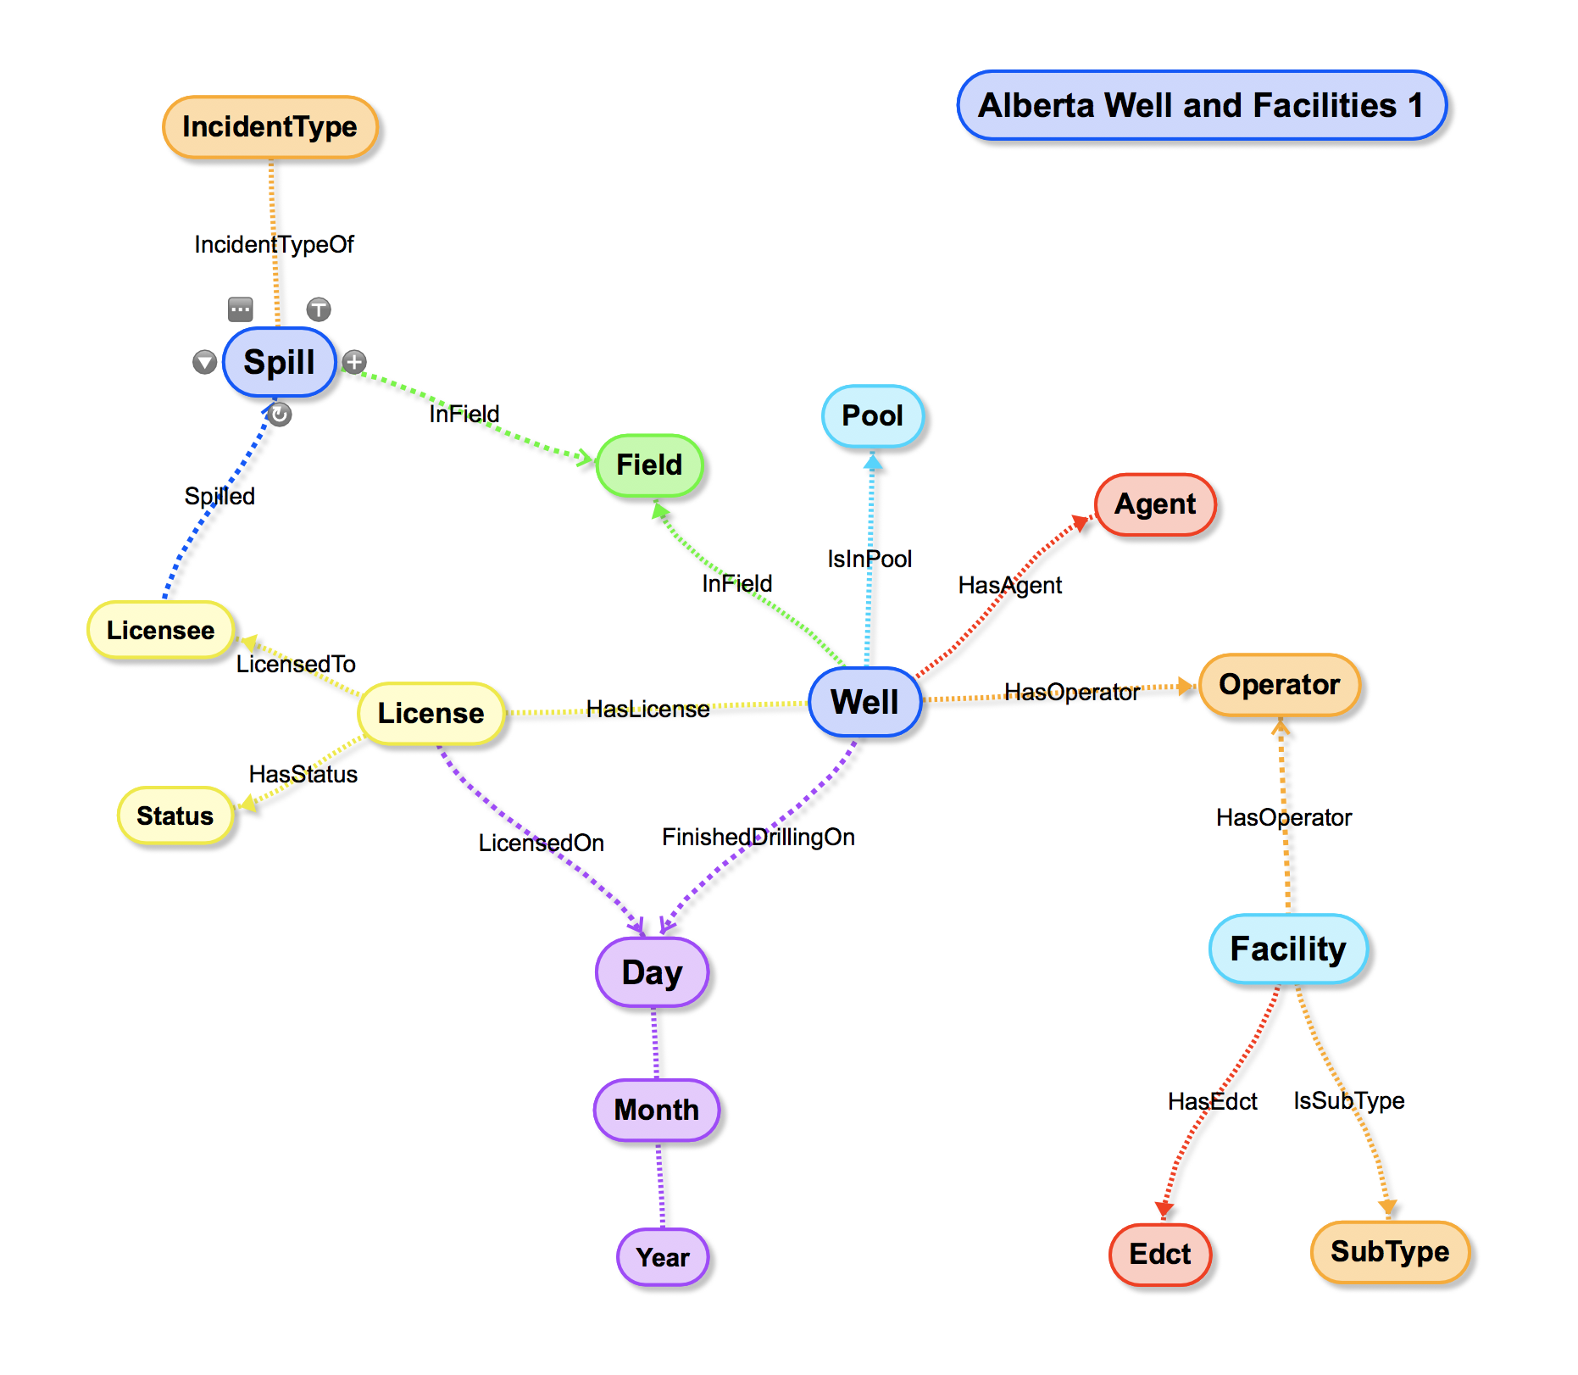
Add more value to data by combining sets
Best Approach is to turn what would normally be properties into Nodes wherever possible

Slide 34
Now – lets bring in some spill data from Edmonton Open Data JSON feed
Goal here is to add Spills in in one shot directly from the JSON service, adding to known licensees and fields etc. where they exist.

Slide 35
Neo4j can directly connect to JSON services, and transform JSON into the graph.. For fun, we’ll do this live..
{
"area_affected": "Conversion from ENV system",
"cause_category": "Conversion",
"cause_type": "Conversion",
"environment_affected": "Air/Land",
"failure_type": "Operator Error",
"fatality_count": "0",
"field_centre": "Medicine Hat",
"incident_complete_date": "1998-11-20T00:00:00.000",
"incident_date": "1998-11-19T00:00:00.000",
"incident_lsd": "2",
"incident_meridian": "4",
"incident_notification_date": "1998-11-19T00:00:00.000",
"incident_number": "19982857",
"incident_range": "12",
"incident_section": "8",
"incident_township": "24",
"incident_type": "Release",
"injury_count": "0",
"licensee_id": "0NL2",
"licensee_name": "Crestar Energy Inc.",
"location": "02-08-024-12W4",
"location_1": {
"type": "Point",
"coordinates": [
-111.6417,
51.0249
]
},
"public_affected": "Conversion from ENV system",
"release_cleanup_date": "1998-11-20T00:00:00.000",
"release_offsite": "No",
"sensitive_area": "No",
"source": "Crude Oil Group Battery",
"strike_area": "CESS",
"substance_released": "Condensate",
"volume_recovered": "1",
"volume_released": "1",
"volume_units": "m3",
"wildlife_livestock_affected": "Conversion from ENV system"
},

Slide 36
Graph Refactoring
It is possible to change and adapt the graph
Can improve performance
Adapt and adjust model to bring new insight

Slide 37
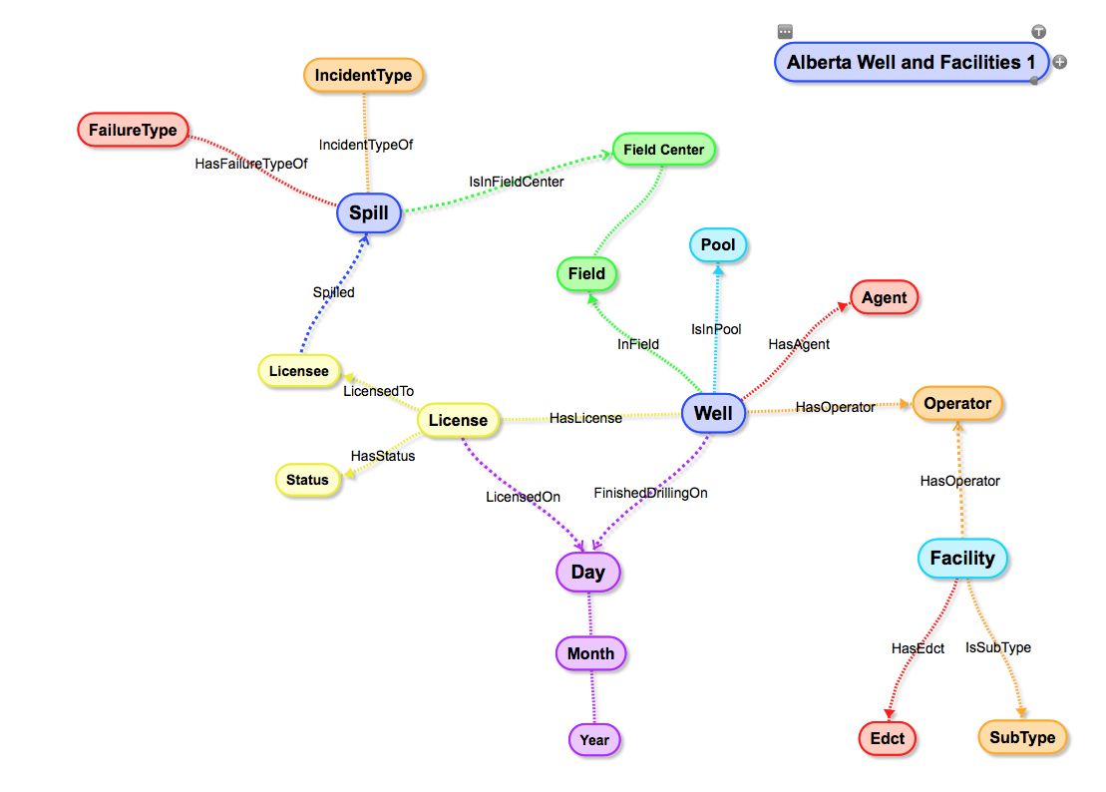
Add more value by refactoring data
Best Approach is to turn what would normally be properties into Nodes wherever possible.
In this case, we want to turn the FailureType into a property so that we can easily classify Spills, find out which Licensees had what failure types etc.

Slide 38
// Spill FailureType - refactor property to Node
// lets say we want to convert a property to a node:
MATCH (s:Spill)
where s.FailureType <> ''
CALL apoc.create.uuids(1) YIELD uuid as Uuid
MERGE (f:FailureType:Card {Name:s.FailureType})
ON CREATE
set
f.Uuid = Uuid
MERGE (s)-[:HasFailureType]->(f)
REMOVE s.FailureType;
This statement finds nodes with FailureType property set, generates a UUID, and creates a new node using the FailureType property as the Name.
It then generates the new relationship with the Spill.
Finally: it removes the property from the Spill Node.

Slide 39
Add more value to data by refactoring relationships
The Spill-Field relationship is very dense. We also notice that Field has a property on it called FieldCenter.
Extracting FieldCenter to a node gives us a more efficient, cleaner pattern for working with the data.

Slide 40
// TOO MANY IsInField->Spill links
// Refactor Field Center out of Fields
MATCH (f:Field)
where f.FieldCenter <> ''
CALL apoc.create.uuids(1) YIELD uuid as Uuid
MERGE (fc:FieldCenter:Card {Name:f.FieldCenter})
ON CREATE
set
f.Uuid = Uuid
MERGE (f)-[:IsCenteredIn]->(fc)
REMOVE f.FieldCenter;
// remap relationship with spill:
MATCH (s:Spill)-[d:IsInField]->(f:Field)
MATCH (fc:FieldCenter) where fc.Name=f.Name
MERGE (s)-[:IsInFieldCenter]->(fc);
// now delete the spill-Field relationship
MATCH (s:Spill)-[d:IsInField]->(f:Field)
DELETE d
This statement finds Field nodes with FieldCenter property set.
It uses the FieldCenter property to create a new FieldCenter node, creates a new relationship with the Field Node and removes the original property.
We then remap the relationship with the Spill to use the new FieldCenter node, and delete the Spill-Field relationship.

Slide 41
Neo4j makes mountains of data easy to integrate and work with!

Slide 42
-->theLink<--
: stop searching --> start finding :
(Menome Technologies Knowledge Platform)
https://www.menome.com

